Slide 1
Forest Protection weeds
Jakub Horák

Slide 2
Forest Protection
Biotics

Slide 3
Forest Protection
Biotic factors:
Insect
Game stocks
Weeds
Fungi
…

Slide 4
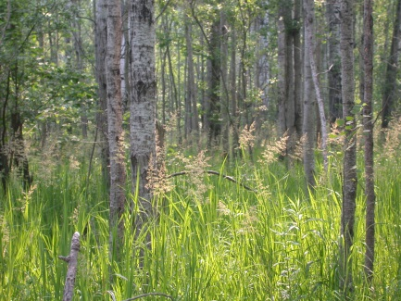
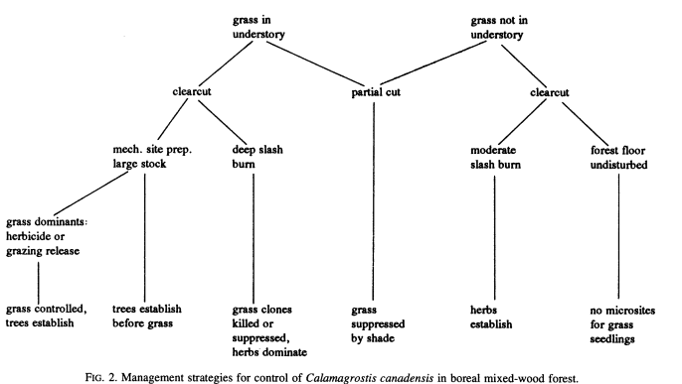
Forest Protection Management practices
botany.wisc.edu

Slide 5
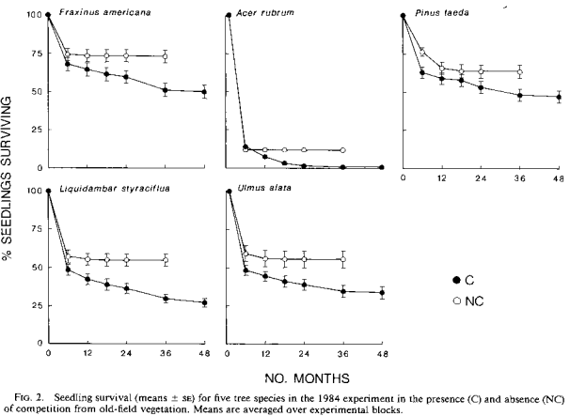
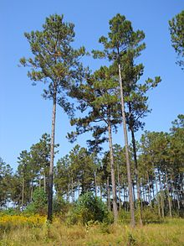
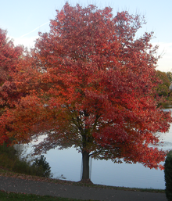
Forest Protection Afforestation
Acer rubrum (Red Maple), is one of the most common and widespread deciduous trees of eastern North America.
Pinus taeda (loblolly pine) is the second most common species of tree in the United States, after red maple – fire.
en.wikipedia.org

Slide 6
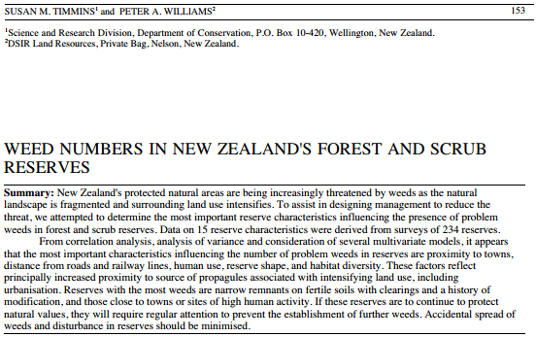
Forest Protection Aliens

Slide 7
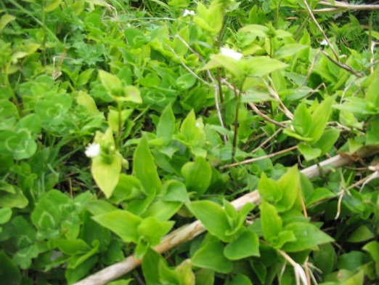
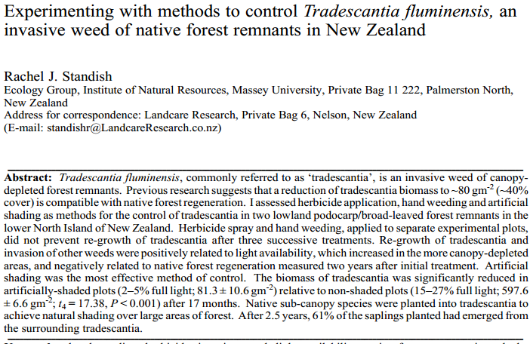
Forest Protection Individual species
en.wikipedia.org
ubiquitous urban weed (wandering Jew) capable of causing allergic dermatitis in dogs

Slide 8
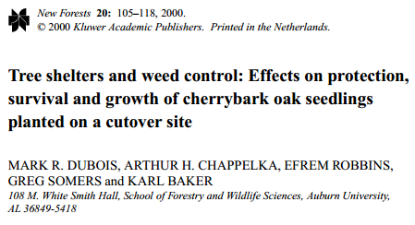
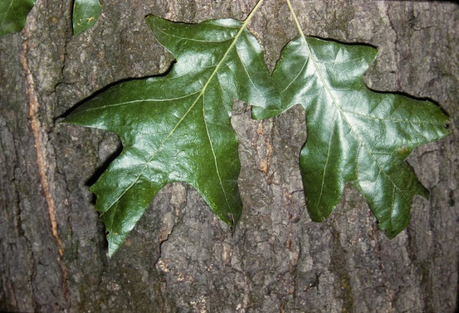
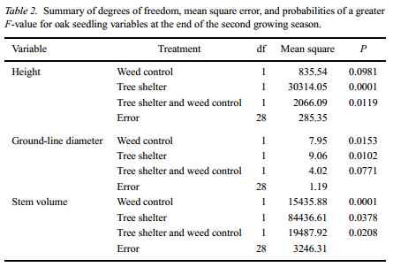
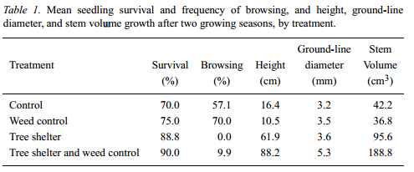
Forest Protection Good weeds
www.phytoimages.siu.edu

Slide 9
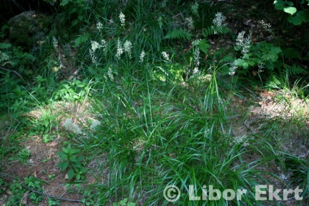
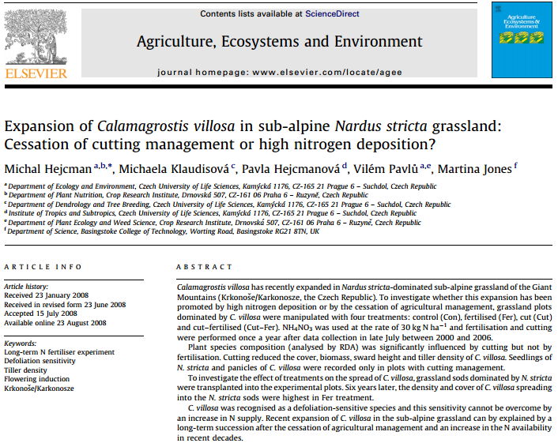
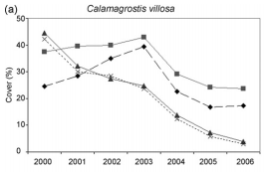
Forest Protection Succession or nitrogen?

Slide 10
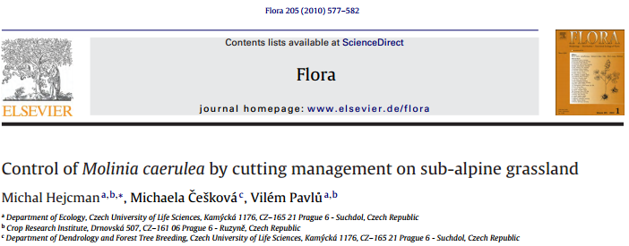
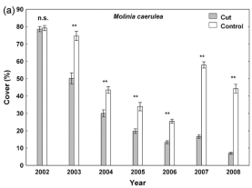
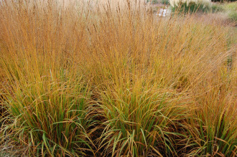
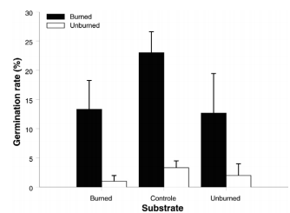
Forest Protection Fire and weeds
davisla.wordpress.com

Slide 11
Forest Protection Conclusions
Mechanical: cutting, mowing, pasturing etc.
Chemical: mostly herbicides
Forest nurseries: weed is everything except of target seedlings
Forest stands: some are weeds, some neutral, while some might be beneficial (e.g. shrubs and high game stocks)
Grasses, shrubs and aliens

Slide 12
Thank you for your attention

